Slide 1
Global Wheat Head Detection Challenge
Contact: Professor Scott Chapman
UQ School of Agriculture and Food Sciences

Slide 2

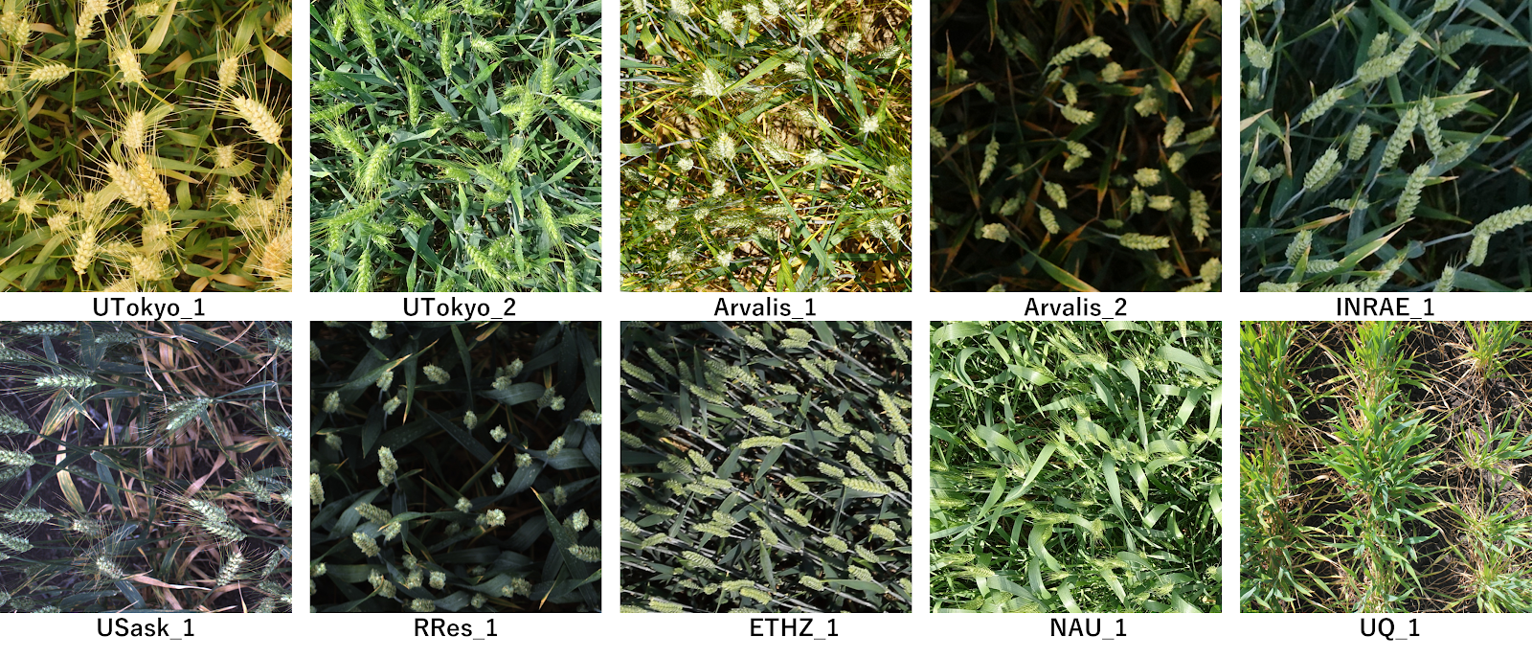
The global wheat head dataset is a collection of images of wheat plants captured with a wide range of ground-based cameras.
https://spj.sciencemag.org/journals/plantphenomics/2020/3521852/

Slide 3
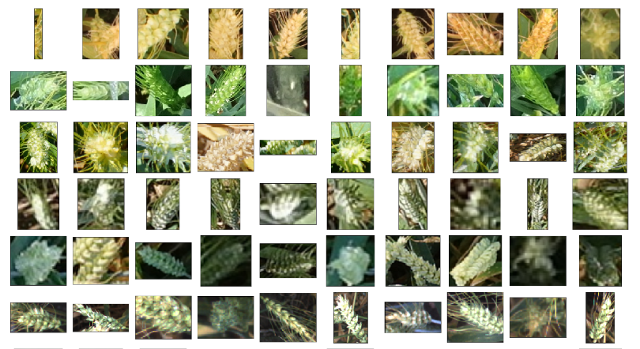
The dataset contains images with a wide range of illumination conditions and backgrounds, in addition to, variability in head sizes orientation and view directions.

Slide 4
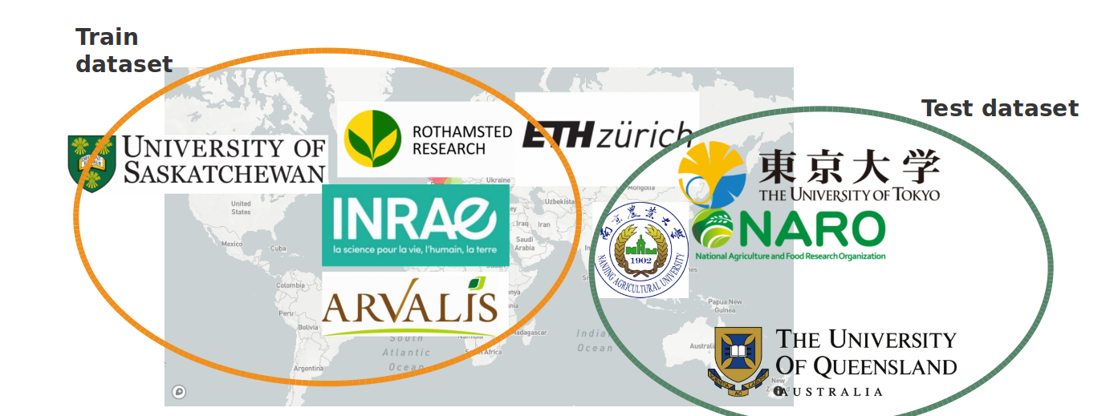
Training and Testing Set
Training Set: Images from Europe and North America
Testing Set: Images from Australia, Japan and China

Slide 5
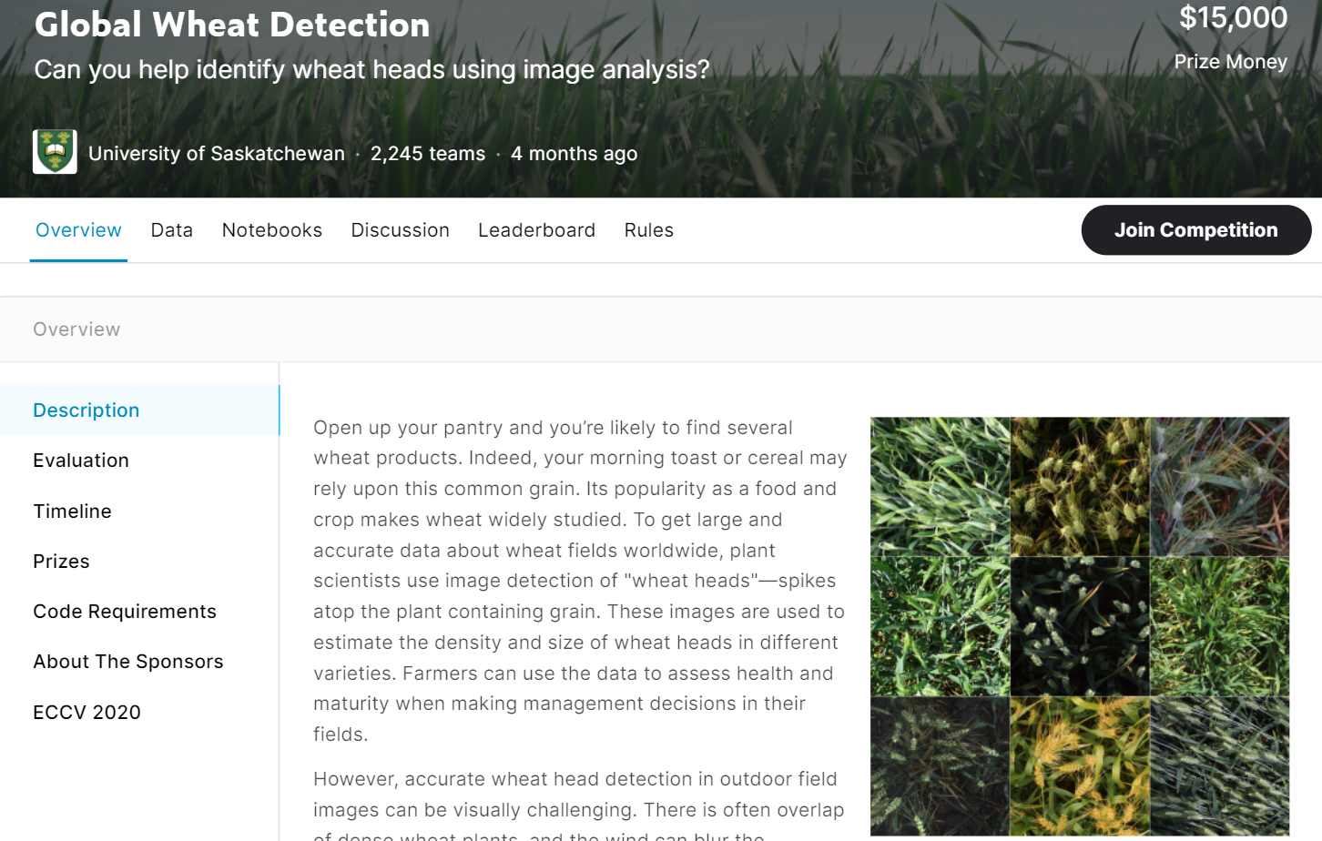
Kaggle Competition – July 2020
Link: https://www.kaggle.com/c/global-wheat-detection/

Slide 6
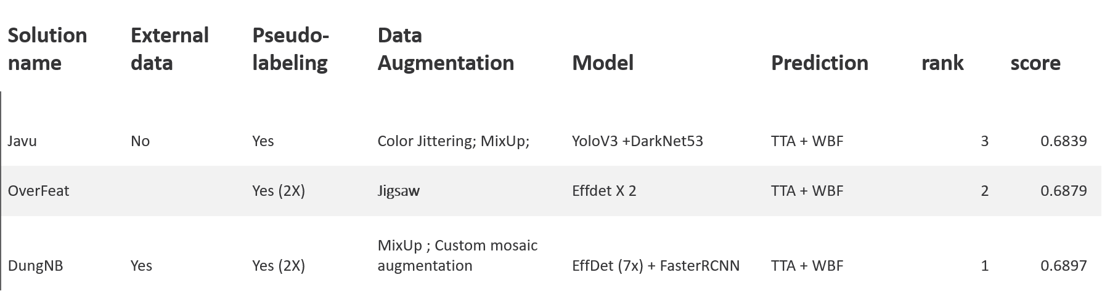
Kaggle competition Results

Slide 7
OBJECTIVE:
Extend upon results from Kaggle competition and improve model performance

Slide 8
Winning Solutions
Data Augmentation (Mosaic Augmentation)
Pseudo Labelling
Test-Time Augmentation

Slide 9
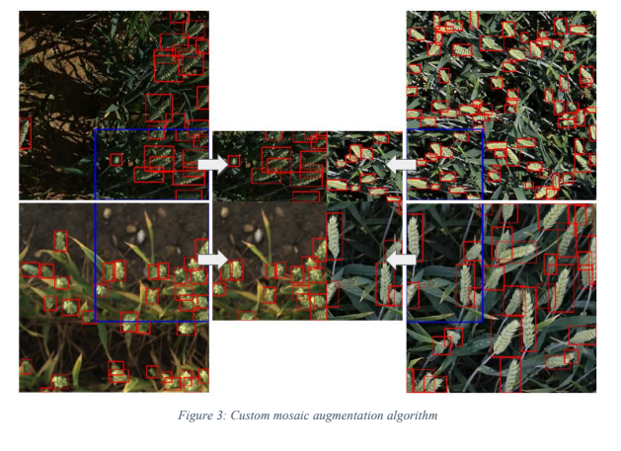
Mosaic Augmentation

Slide 10
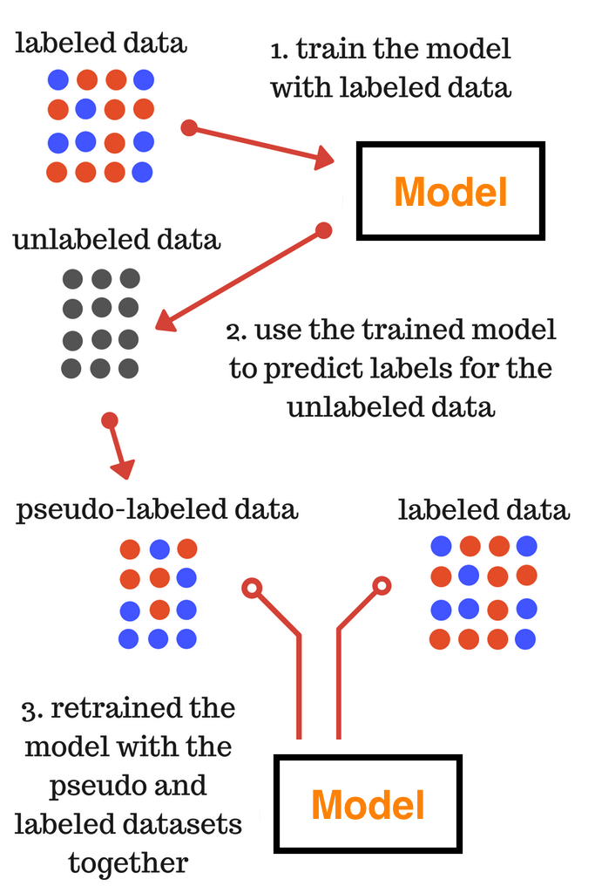
Pseudo Labelling

Slide 11
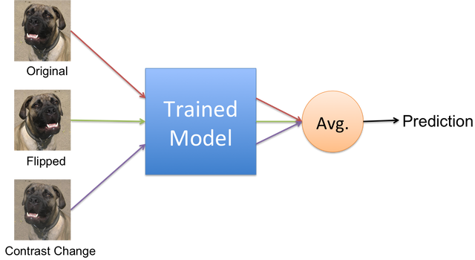
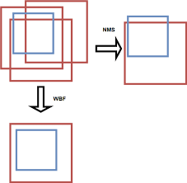
Test Time Augmentation & Weighted boxes Fusion
Weighted Boxes Fusion

Slide 12
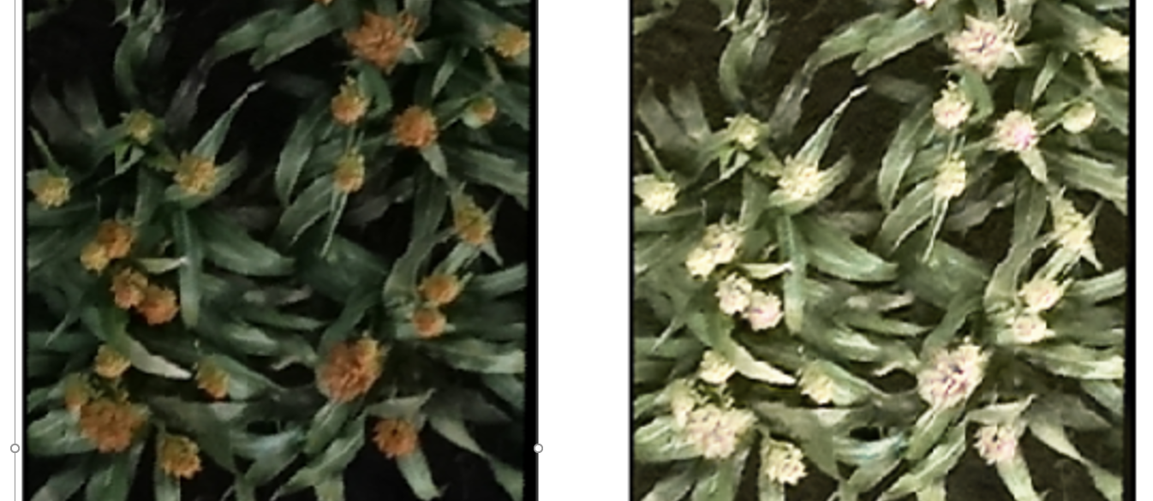
Additional Methods to Test: GAN based Image Augmentation
Use CycleGAN/CutGAN to generate synthetic images
Augment images to alter illumination, background, colour
Original
Synthetic
Example: Using CutGAN to augment illumination settings and colour of sorghum heads

Slide 13
Competition Details
Link to Dataset: https://zenodo.org/record/4298502#.X8UAts6Slyw
Link to competition: https://competitions.codalab.org/competitions/27449
Kaggle Results: http://www.global-wheat.com/2020/11/09/key-lessons-learned-from-global-wheat-kaggle-challenge/

Slide 14
Thank you

